Slide 1
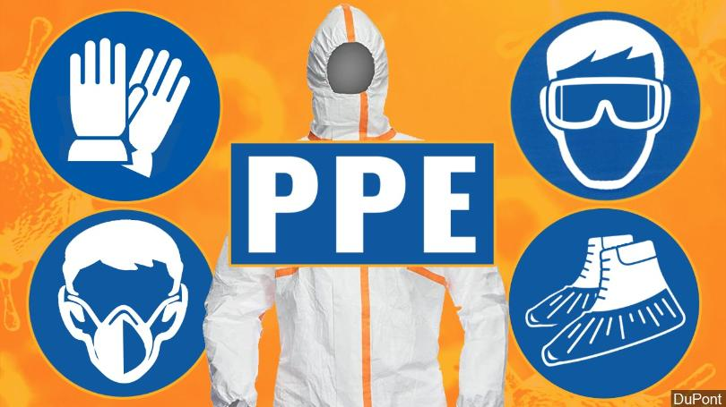
Universidad Tecnológica Nacional Reconquista
2021
UNIT 2:
Personal Protective Equipment

Slide 2
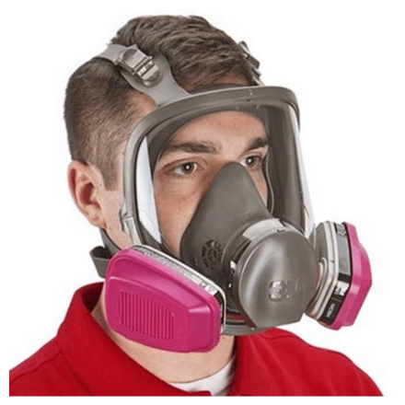
Universidad Tecnológica Nacional Reconquista
2021
What is personal protective equipment?
is equipment worn to minimize exposure to hazards that cause serious workplace injuries and illnesses.
may include items such as:
Gloves
Safety glasses and shoes
Coveralls, vests and full body suits
Hard hats
Respirators
Earplugs or muffs

Slide 3
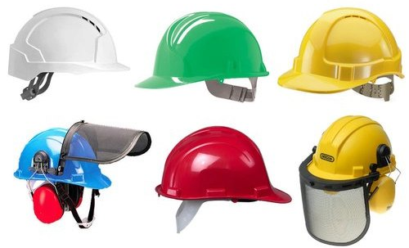
Universidad Tecnológica Nacional Reconquista
2021
Protection from Head Injuries
Hard hats can protect your workers from head impact, penetration injuries, and electrical injuries such as those caused by falling or flying objects, fixed objects, or contact with electrical conductors.

Slide 4
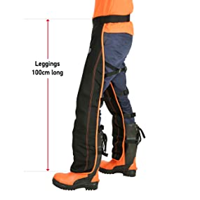
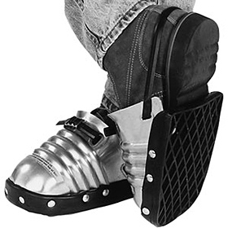
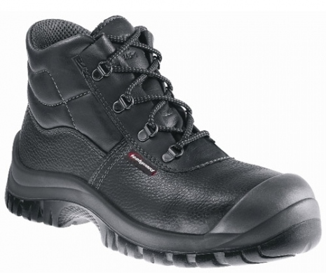
Universidad Tecnológica Nacional Reconquista
2021
Protection from Foot and Leg Injuries
Foot guards, safety shoes and leggings can help prevent injuries by protecting workers from hazards such as falling or rolling objects, sharp objects, wet and slippery surfaces, molten metals, hot surfaces, and electrical hazards.

Slide 5
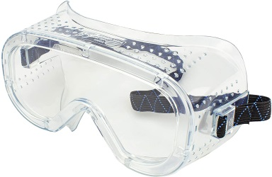
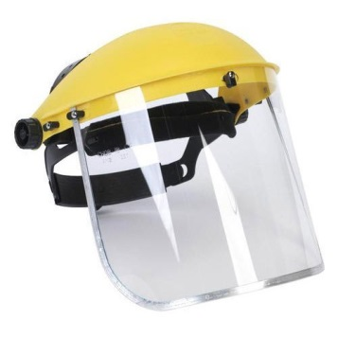
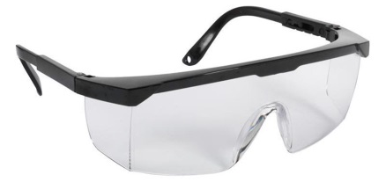
Universidad Tecnológica Nacional Reconquista
2021
Protection from Eye and Face Injuries
Spectacles, goggles, spectacles with side shields, and face shields can protect workers from the hazards of flying fragments, large chips, hot sparks, optical radiation, splashes from molten metals, as well as objects, particles, sand, dirt, mists, dusts, and glare.

Slide 6
Universidad Tecnológica Nacional Reconquista
2021
Protection from Hearing Loss
Wearing earplugs or earmuffs can help prevent damage to hearing. Earplugs made from foam, waxed cotton, or fiberglass wool are self-forming and usually fit well. Clean earplugs regularly, and replace those you cannot clean.

Slide 7
Universidad Tecnológica Nacional Reconquista
2021
Protection from Hand Injuries
Workers exposed to harmful substances through skin absorption, severe cuts or lacerations, severe abrasions, chemical burns, thermal burns, and harmful temperature extremes will benefit from hand protection.

Slide 8
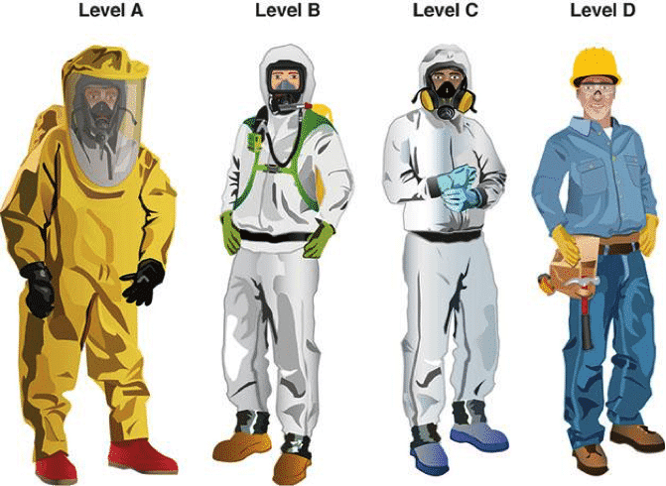
Universidad Tecnológica Nacional Reconquista
2021
Protection from Body Injury
In some cases workers must shield most or all of their bodies against hazards in the workplace, such as exposure to heat and radiation as well as hot metals, scalding liquids, body fluids, hazardous materials or waste, and other hazards. In addition to fire-retardant wool and fire retardant cotton, materials used in whole-body personal protective equipment include rubber, leather, synthetics, and plastic.

Slide 9
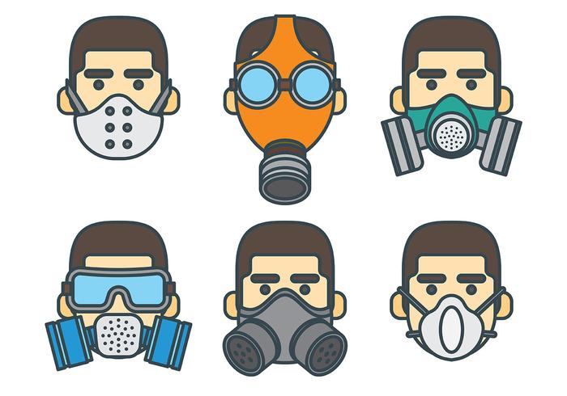
Universidad Tecnológica Nacional Reconquista
2021
When to Wear Respiratory Protection
Workers must use appropriate respirators to protect against adverse health effects caused by breathing air contaminated with harmful dusts, fogs, fumes, mists, gases, smokes, sprays, or vapors. Respirators generally cover the nose and mouth or the entire face or head.

Slide 10
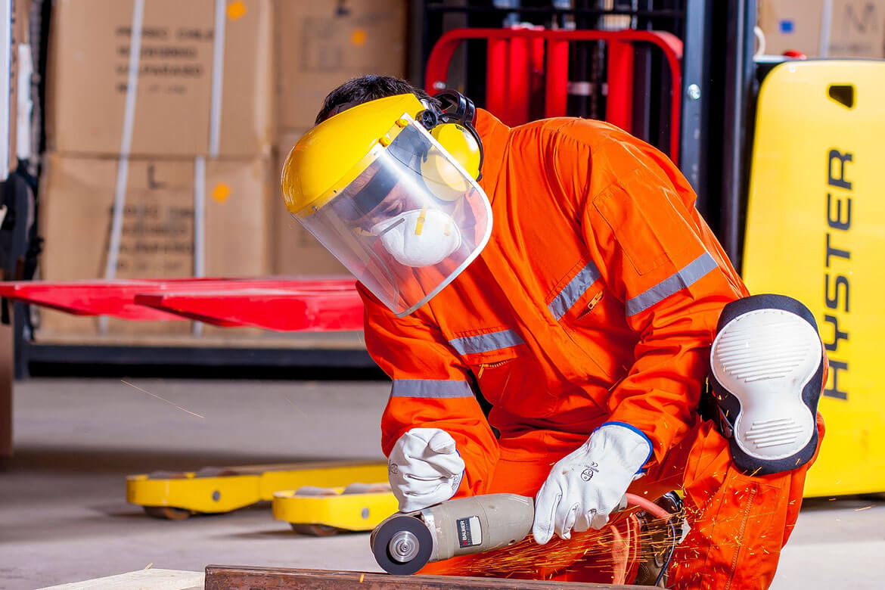
Universidad Tecnológica Nacional Reconquista
2021
What PPE can you see in this photo? Label the picture.

Slide 11
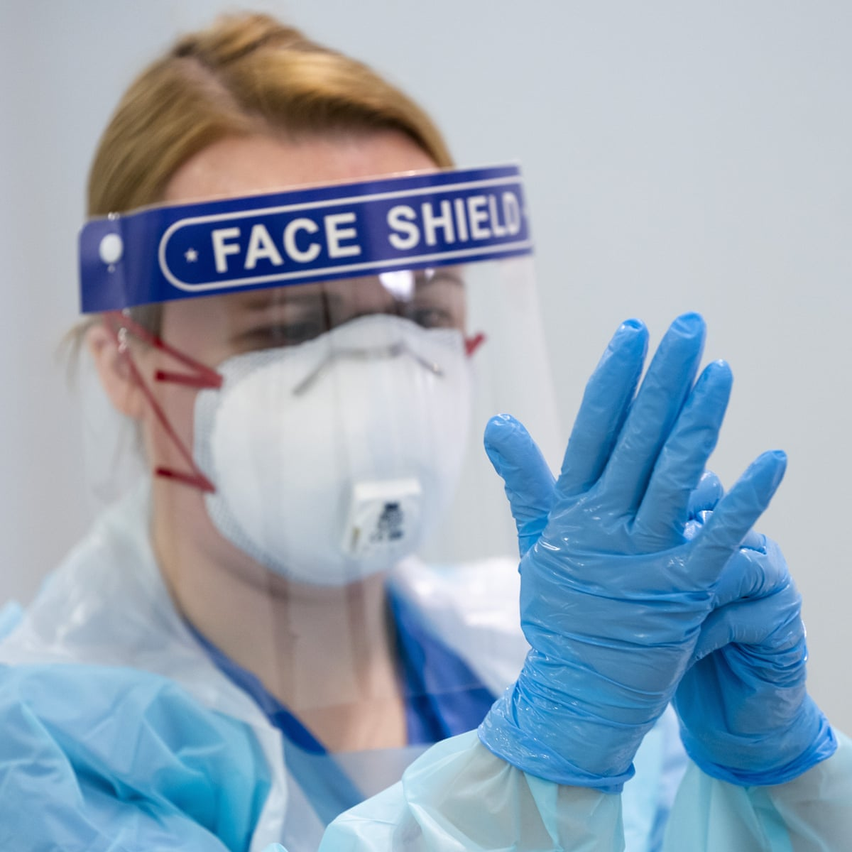
Universidad Tecnológica Nacional Reconquista
2021
What PPE can you see in this photo? Label the picture.

Slide 12
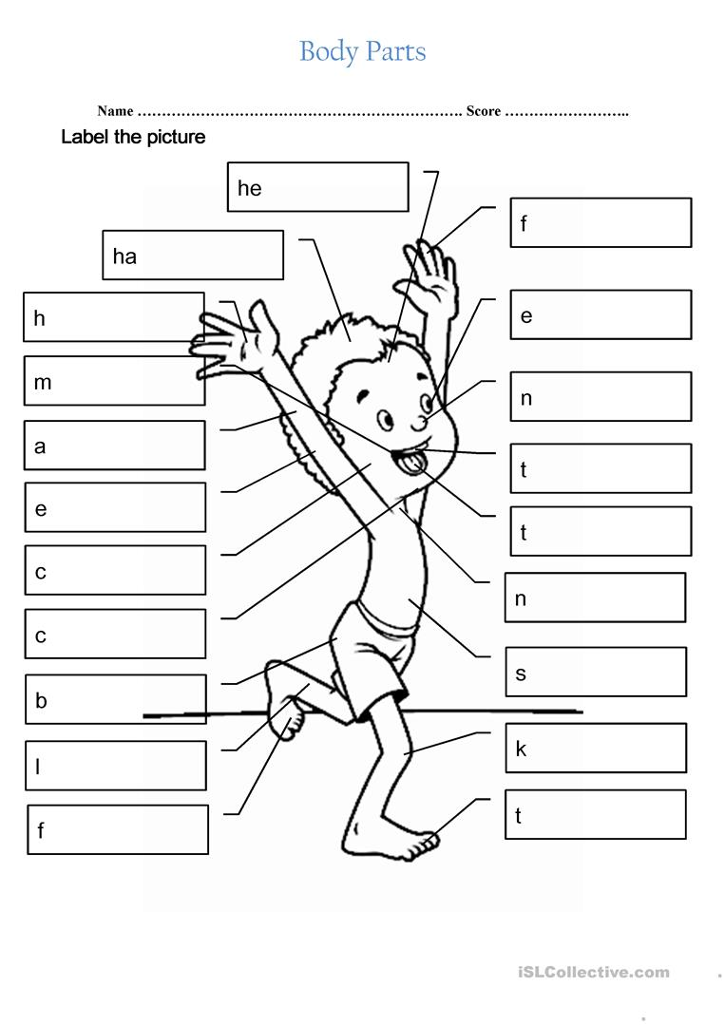
Universidad Tecnológica Nacional Reconquista
2021
Complete the picture with body parts.

Slide 13
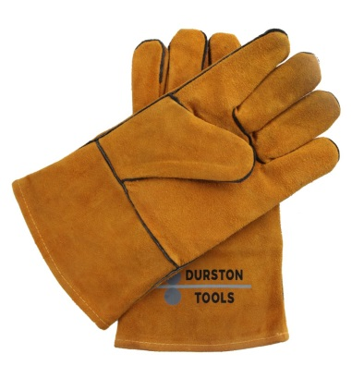
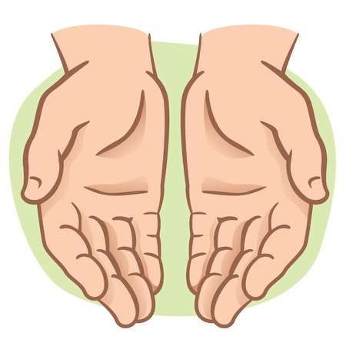
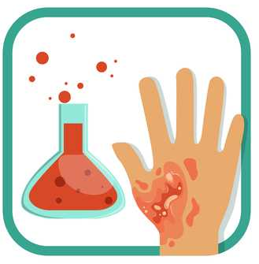
Universidad Tecnológica Nacional Reconquista
2021
Safety gloves
the hands
chemical burns
………………. PROTECT ………………. FROM ……………….

Slide 14
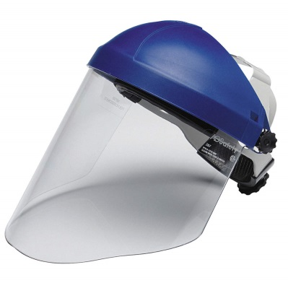
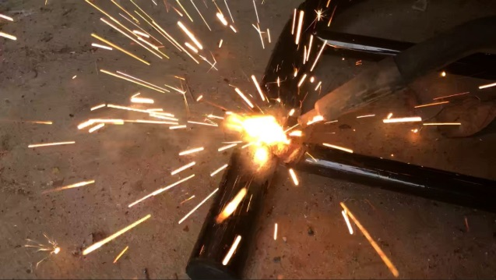
Universidad Tecnológica Nacional Reconquista
2021
Face shields
the face
hot sparks
………………. PROTECT ………………. AGAINST……………….

Slide 15
Universidad Tecnológica Nacional Reconquista
2021

Slide 16
Universidad Tecnológica Nacional Reconquista
2021
ACTIVITY 1: Read the collocations to make sentences.
Protect (part of the body)
Earplugs protect the ears.
Protect (part of the body) from (hazard)
Earplugs protect the ears from loud noise.
Protect (part of the body) against (hazard)
Earplugs protect the ears against loud noise.
Protect from doing something:
The mask protects from inhaling harmful air particles such as dusts, vapours, fumes and gases.

Slide 17
Universidad Tecnológica Nacional Reconquista
2021
keep (somebody/something) from something: to prevent someone from doing something or prevent something from happening
Keep somebody from (doing) something
The safety harness keeps the worker from falling. // Safety gloves keep the chef from burning his hands.
Keep something from doing something
Put the pizza in the bottom of the oven to keep the cheese from burning.

Slide 18
Universidad Tecnológica Nacional Reconquista
2021
Protect (part of the body): to keep someone or something safe from harm, damage, or illness.
Earplugs protect the ears.
Protect (part of the body) from (hazard)
Earplugs protect the ears from loud noise.
Protect (part of the body) against (hazard)
Earplugs protect the ears against loud noise.
Protect from doing sth
The mask protects from inhaling harmful air particles such as dusts, vapours, fumes and gases.

Slide 19
Universidad Tecnológica Nacional Reconquista
2021
Avoid: to prevent something bad from happening.
Avoid something
It is important to take measures to avoid the risk of fire.
Don’t touch the wires to avoid getting an electric shock.
Avoid SOMEONE/SOMEBODY doing sth SOMETHING
The safety harness avoids the worker falling.
Prevent: to stop something from happening, or stop someone from doing something.
Prevent somebody/something (from) doing something
His back injury may prevent him from playing in tomorrow’s game.
WEARING SAFETY GLOVES PREVENT THE WORKER FROM CUTTING HIS/HER HANDS

Slide 20
Universidad Tecnológica Nacional Reconquista
2021
Help: to make it possible or easier for someone to do something by doing part of their work or by giving them something they need.
Help somebody (to) do something
I helped her to carry her cases up the stairs.
Help somebody with something
Can I help you with the washing up?

Slide 21
Universidad Tecnológica Nacional Reconquista
2021
………………. PROTECT ………………. AGAINST……………….
………………. PROTECT ………………. FROM ……………….
………………. PROTECT ……………….

Slide 22
Universidad Tecnológica Nacional Reconquista
2021
………………. PROTECT ………………. AGAINST……………….
………………. PROTECT ………………. FROM ……………….
………………. PROTECT ……………….

