Slide 1
WHY USE SAFETY SIGNS?
These pictures may not say a thousand words, but they are universally recognized symbols that transcend language.
No matter where you’re working, you’ll be able to understand the potential hazards you face simply by looking at the posted symbols.

Slide 2
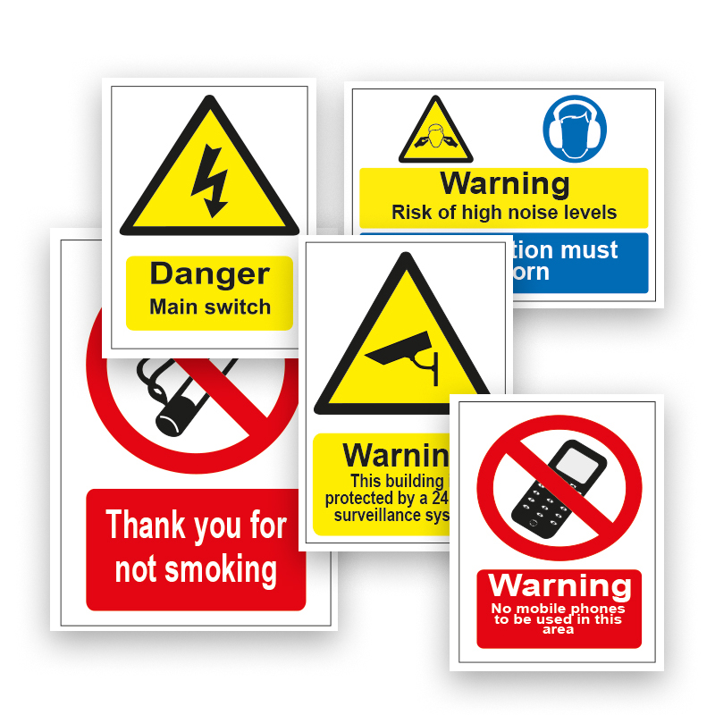
WHAT IS A SAFETY SIGN?
A safety and/or health sign is defined as ‘information or instruction about health and safety at work on a signboard, a colour, an illuminated sign or acoustic signal, a verbal communication or hand signal.’

Slide 3
Each category has its own specific colour and sign shape that remains consistent around the world as per safety regulations.
By getting to know the key characteristics of each type of symbol, you’ll be able to easily identify whether a sign is asking you to stop doing something, start doing something, take precautions, or advising you of emergency equipment or facilities.

Slide 4
Safety Sign Composition
Safety signs are usually composed of at least one of three parts:
1. The signal word is the term used to indicate a hazard's degree of severity. These words (such as "danger", "warning", and "caution") are usually association with certain colors (red, orange, and yellow respectively).
2. The message panel is the portion of the sign used to identify the hazard and indicate how to avoid it. These descriptions also have standards linked to specified colors for different situations.
3. Some signs include a symbol or pictorial which is associated with a specific signal word or hazard. These give a visual indication of the hazard that is recognizable and universally understood.

Slide 5
WHAT IS A Signboard ?
It’s a sign which provides information or instructions by a combination of shape, colour and a symbol or pictogram which is rendered visible by lighting of sufficient intensity. Signboards can be of the following types:
Prohibition
Warning
Mandatory
Emergency

Slide 6
SAFETY SIGNS AND THEIR MEANINGS
COLOUR | MEANING OR PURPOSE | INSTRUCTION & INFORMATION | INTRINSIC FEATURES
Prohibition/Danger alarm
Dangerous behaviour;
stop; shutdown;
emergency cut-out
devices; evacuate
Round shape; black pictogram on white background; red edging and diagonal line; red part to be at least 35% of the area of the sign
RED

Slide 8
SAFETY SIGNS AND THEIR MEANINGS
COLOUR | MEANING OR PURPOSE | INSTRUCTION & INFORMATION | INTRINSIC FEATURES
YELLOW or AMBER
Warning
Be careful; take precautions; examine
Triangular shape; black pictogram on yellow background with black edging; yellow part to be at least 50% of the area of the sign

Slide 10
SAFETY SIGNS AND THEIR MEANINGS
COLOUR | MEANING OR PURPOSE | INSTRUCTION & INFORMATION | INTRINSIC FEATURES
Round shape; white pictogram on blue background; blue part to be at least 50% of the area of the sign
BLUE
Mandatory
Specific behaviour or action e.g. wear personal protective equipment

Slide 12
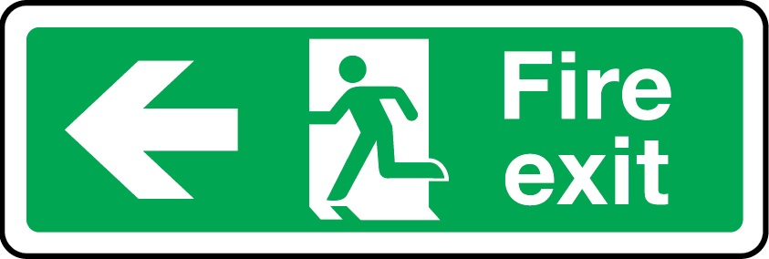
SAFETY SIGNS AND THEIR MEANINGS
COLOUR | MEANING OR PURPOSE | INSTRUCTION & INFORMATION | INTRINSIC FEATURES
GREEN
Emergency escape; first aid. No danger
Doors; exits; escape routes equipment and facilities Return to normal
Rectangular or square shape; white pictogram on green background; green part to be at least 50% of the area of the sign

Slide 14
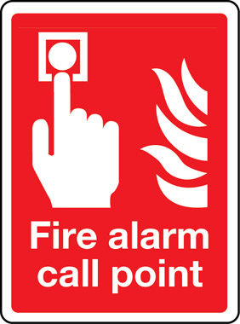
SAFETY SIGNS AND THEIR MEANINGS
COLOUR | MEANING OR PURPOSE | INSTRUCTION & INFORMATION | INTRINSIC FEATURES
RED (fire-fighting signs)
Fire fighting equipment
Identification & location
Rectangular or square shape; white pictogram on red background; red part to be at least 50% of the area of the sign

Slide 16
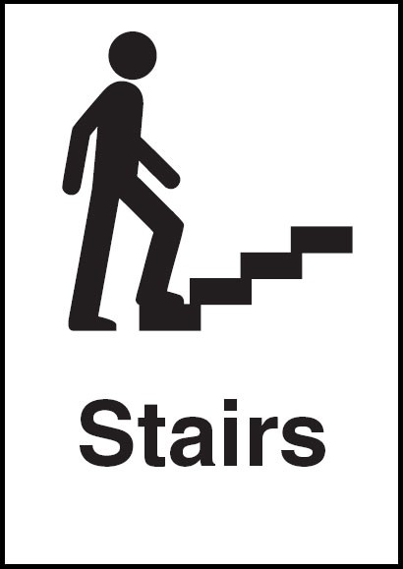
SAFETY SIGNS AND THEIR MEANINGS
COLOUR | MEANING OR PURPOSE | INSTRUCTION & INFORMATION | INTRINSIC FEATURES
BLACK
General Information
Give indication of a certain activity or area set aside for certain activities, as well as information on general enquiries.
Rectangular or square shape; black pictogram on white background

Slide 17
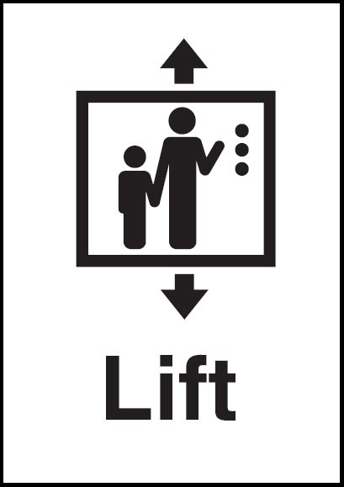
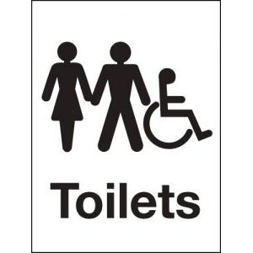
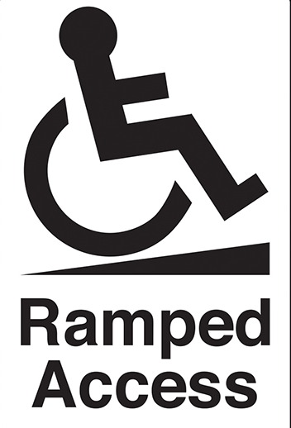
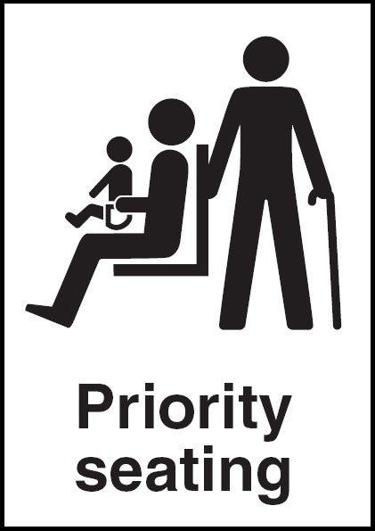

Slide 18
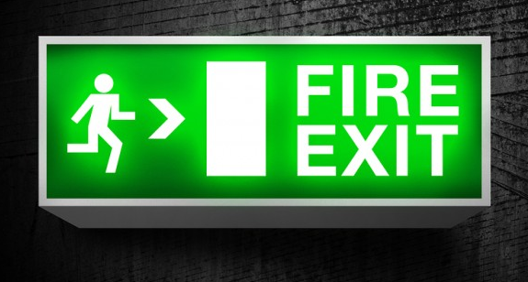
regulations
safety colour
A colour to which a specific meaning is assigned (e.g. yellow means ‘be careful’ or ‘take precautions’)
symbol or pictogram
They are for use on a signboard or illuminated sign (e.g. the trefoil ionising radiation warning sign)
Illuminated signs
A sign made of transparent or translucent materials which is illuminated from the inside or the rear to give the appearance of a luminous surface.

Slide 19
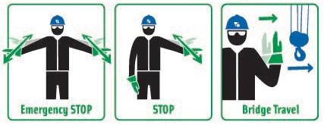
acoustic signal
A sound signal which is transmitted without the use of a human or artificial voice. (e.g. a fire alarm)
verbal communication
A predetermined spoken message communicated by a human or artificial voice.
hand signal
A movement or position of the arms or hands giving a recognised signal and guiding people who are carrying out maneuvers which are a hazard or danger to people.

