Slide 1
Universidad Tecnológica Nacional Reconquista
Occupational Safety and Health Technicians
Inglés Técnico I 2021
UNIT 1

Slide 2
Universidad Tecnológica Nacional Reconquista
Unit 1 - Hazards
What is a ‘hazard’?

Slide 3
Universidad Tecnológica Nacional Reconquista
Hazard: collocations
Unit 1 - Hazards
Workplace Safety and Health refer to dangers as “hazards” and accidents are called “incidents”.

Slide 4
Universidad Tecnológica Nacional Reconquista
Unit 1 - Hazards
SAFETY HAZARDS
Cause accidents and injuries.
Cause immediate harm.
HEALTH HAZARDS
Cause disease or illness.
Disease may take years to develop.
May cause broken bones, cuts, bruises, sprains or electrocutions.
Examples of diseases are cancer, heart disease, loss of hearing or reproductive problems.

Slide 5
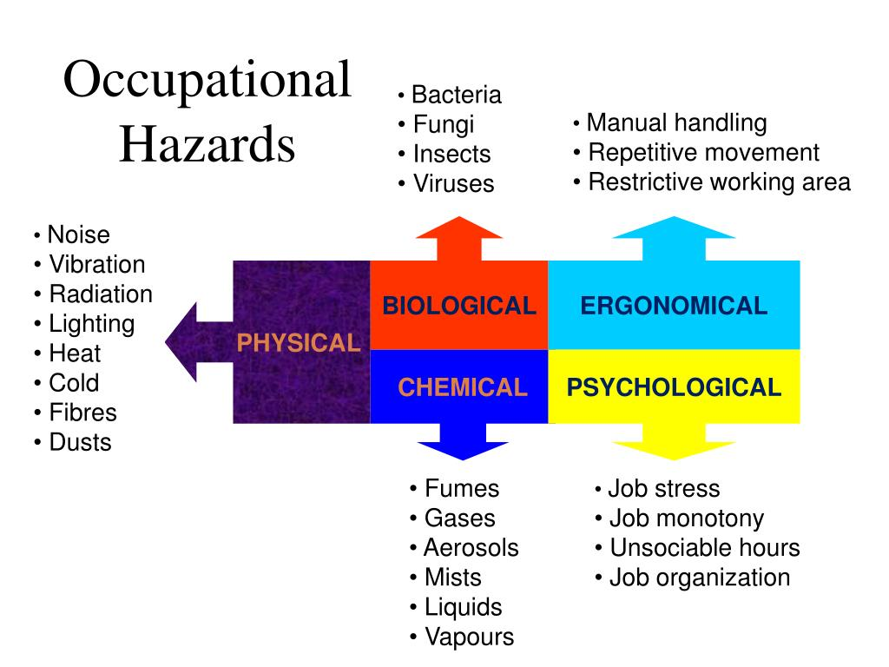
Universidad Tecnológica Nacional Reconquista
Types of Health Hazards
Unit 1 - Hazards

Slide 6
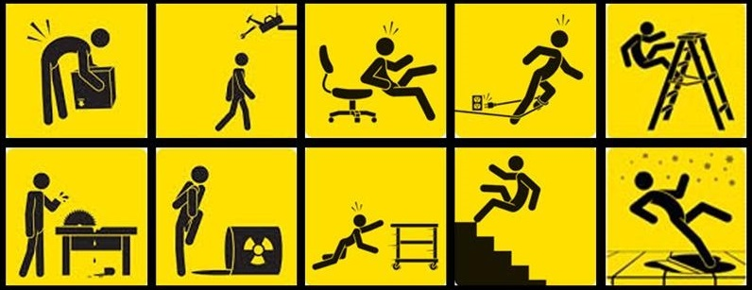
Universidad Tecnológica Nacional Reconquista
Unit 1 - Hazards
Physical Hazards are factors within the environment that can harm the body without necessarily touching it.
Physical Hazards include:
Radiation: including ionizing, non-ionizing (EMF’s, microwaves, radiowaves, etc.)
High exposure to sunlight/ultraviolet rays.
Temperature extremes – hot and cold.
Constant loud noise.

Slide 7
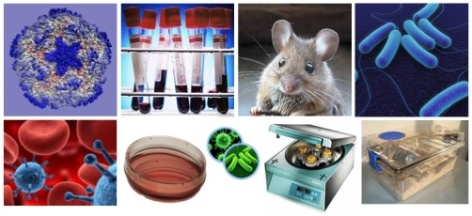
Universidad Tecnológica Nacional Reconquista
Unit 1 - Hazards
Biological Hazards associated with working with animals, people, or infectious plant materials.
Types of things you may be exposed to include:
Blood and other body
fluids
Fungi/mold
Bacteria and viruses
Plants
Insect bites
Animal and bird
droppings

Slide 8
Universidad Tecnológica Nacional Reconquista
Unit 1 - Hazards
Ergonomic hazards occur when the type of work, body positions and working conditions put strain on your body.
Short-term exposure may result in “sore muscles” the next day or in the days following exposure, but long-term exposure can result in serious long-term illnesses.
Ergonomic Hazards include:
Improperly adjusted workstations and chairs
Frequent lifting
Poor posture
Awkward movements, especially if they are repetitive
Repeating the same movements over and over
Having to use too much force, especially if you have to do it
frequently
Vibration

Slide 9
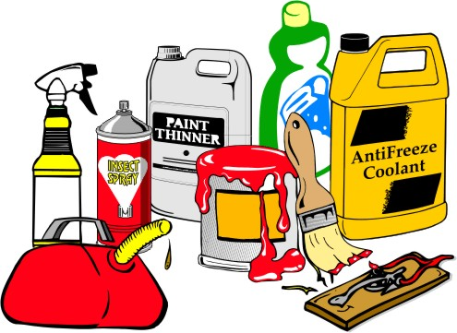
Universidad Tecnológica Nacional Reconquista
Unit 1 - Hazards
Chemical Hazards are present when a worker is exposed to any chemical preparation in the workplace in any form (solid, liquid or gas).
Beware of:
Liquids like cleaning products, paints, acids,
solvents.
Vapors and fumes that come from welding
or exposure to solvents.
Gases like acetylene, propane, carbon
monoxide and helium.
Flammable materials like gasoline, solvents,
and explosive chemicals.
Pesticides .

Slide 10
Universidad Tecnológica Nacional Reconquista
Unit 1 - Hazards
Psychological Hazards or stressors that cause stress (short-term effects) and strain (long-term effects).
Examples of psychological hazards include:
Workload demands
Workplace violence
Intensity and/or pace
Respect (or lack of)
Flexibility
Control or say about things
Social support/relations
Sexual harassment

Slide 11
Universidad Tecnológica Nacional Reconquista
Unit 1 - Hazards
Safety Hazards include:
Slips, trips and falls
Being caught in or struck by moving machinery or other objects
Fire and explosions
Transportation and vehicle‐related accidents
Confined spaces
Violence

Slide 12
Universidad Tecnológica Nacional Reconquista
Unit 1 - Hazards

Slide 13
Universidad Tecnológica Nacional Reconquista
Unit 1 - Hazards

Slide 14
Universidad Tecnológica Nacional Reconquista
Unit 1 - Hazards

Slide 15
Universidad Tecnológica Nacional Reconquista
Unit 1 - Hazards

Slide 16
Universidad Tecnológica Nacional Reconquista
Unit 1 - Hazards

Slide 17
Universidad Tecnológica Nacional Reconquista
Unit 1 - Hazards

Slide 18
Universidad Tecnológica Nacional Reconquista
Unit 1 - Hazards

Slide 19
Universidad Tecnológica Nacional Reconquista
Unit 1 - Hazards

Slide 20
Universidad Tecnológica Nacional Reconquista
Unit 1 - Hazards

Slide 21
Universidad Tecnológica Nacional Reconquista
Unit 1 - Hazards

Slide 22
Universidad Tecnológica Nacional Reconquista
Unit 1 - Hazards

Slide 23
Universidad Tecnológica Nacional Reconquista
Unit 1 - Hazards

Slide 24
Universidad Tecnológica Nacional Reconquista
Unit 1 - Hazards
Workplace Safety and Health refer to dangers as “hazards” and accidents are called “incidents”.

