Slide 1
Universidad Tecnológica Nacional Reconquista
2021
Tecnicatura Universitaria en Higiene y Seguridad en el Trabajo

Slide 2
Universidad Tecnológica Nacional Reconquista
2021
Inglés Técnico I
Lic. Lalli Patricia N.
Horario: Viernes 17 – 18:30 Hs.

Slide 3
Universidad Tecnológica Nacional Reconquista
2021
Objetivos específicos:
- Conocer vocabulario específico de la carrera afín.
Conocer los elementos gramaticales básicos de maniobra para la interpretación de un texto en inglés.
Desarrollar habilidades de lecto-comprensión sobre textos de diferentes temáticas

Slide 4
Universidad Tecnológica Nacional Reconquista
2021
UNIDADES
UNIT 1: OCCUPATIONAL HAZARDS
➔ Health and safety hazards.
➔ Incidents, accidents and symptoms as result of different types of hazards.
➔ Introduction to methods for controlling hazards.

Slide 5
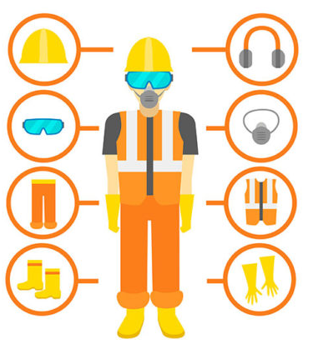
Universidad Tecnológica Nacional Reconquista
2021
UNIDADES
UNIT 2: PPE (Personal Protection Equipment)
➔ Types of PPE and their
functions.

Slide 6
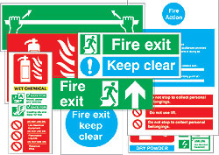
Universidad Tecnológica Nacional Reconquista
2021
UNIDADES
UNIT 3: SAFETY RULES AND PRECAUTION SIGNS.
➔ Safety signs: different
functions according to
colour and shape.
➔ Safety rules for
machinery, tools, dress,
workshop, accident procedures, poisons, toxins and cleaners.

Slide 7
Universidad Tecnológica Nacional Reconquista
2021
EVALUACIÓN:
Aprobación de la cursada:
Asistencia obligatoria a clases (75%)
Trabajos prácticos: aprobar el 75% (2 de 3) con calificación mínima de 5.
Parcial 1: 21/05 Parcial 2: 18/06 Parcial 3: 16/07 Recuperatorio: 19-23/07

Slide 8
Universidad Tecnológica Nacional Reconquista
2021
EVALUACIÓN:
Promoción directa:
Aprobar los 3 (tres) trabajos prácticos con calificación mínima de 6 (seis).

Slide 9
Universidad Tecnológica Nacional Reconquista
2021
- Aquel alumno que cumpla con los requisitos del régimen de cursado, pero no alcance los requisitos para promoción directa, deberá rendir 1 (uno) examen final escrito.
- Aquel alumno que no logre la aprobación de la cursada, deberá recursar la materia el año siguiente.

Slide 10
Universidad Tecnológica Nacional Reconquista
2021
Diccionarios:
-Diccionarios bilingües:
https://www.wordreference.com/es/translation.asp?tranword=a
https://dictionary.cambridge.org/es/
https://www.ldoceonline.com/dictionary/
-Diccionarios monolingües:
https://dictionary.cambridge.org/es/
https://www.ldoceonline.com/dictionary/
https://www.oxfordlearnersdictionaries.com/
https://www.macmillandictionary.com/
https://www.lexico.com/
Dictionary of Occupational Safety and Health Terms
https://osha.oregon.gov/OSHAPubs/english-spanish.pdf

Slide 11
Universidad Tecnológica Nacional Reconquista
2021
Information and material
OSHA: Occupational Safety and Health Administration from the United States Department of Labour.
OSHA's Mission
With the Occupational Safety and Health Act of 1970, Congress created the Occupational Safety and Health Administration (OSHA) to ensure safe and healthful working conditions for working men and women by setting and enforcing standards and by providing training, outreach, education and assistance.
Source: https://www.osha.gov/aboutosha

Slide 12
Universidad Tecnológica Nacional Reconquista
Tecnicatura Universitaria en Higiene y Seguridad en el Trabajo
OCCUPATIONAL SAFETY AND HEALTH TECHNICIAN
OCCUPATIONAL SAFETY AND HEALTH (OSH)
OCCUPATIONAL HEALTH AND SAFETY (OHS)
WORKPLACE SAFETY AND HEALTH
WORKPLACE HEALTH AND SAFETY
JOB SAFETY AND HEALTH

Slide 13
Universidad Tecnológica Nacional Reconquista
2021

Slide 14
Universidad Tecnológica Nacional Reconquista
2021
ACTIVITIES
Read the title and the first paragraph. What is the text about?

Slide 15
Universidad Tecnológica Nacional Reconquista
2. Answer the following questions. (You can underline in the text)
2.1. Why do OHS technicians collaborate with OHS specialists?
2.2. What are typical workplaces for OHS technicians?
2.3. What are the disadvantages of OHS technicians?

Slide 16
Universidad Tecnológica Nacional Reconquista
2021

Slide 17
Universidad Tecnológica Nacional Reconquista
3. Infer the meaning from the context: What’s the meaning of ‘conducting tests’?

Slide 18
Universidad Tecnológica Nacional Reconquista
2021
4. Find the words that match the definitions:
________: (noun) the room, building etc. where people work.
________:(noun) a building, a piece of land, or both together.
________:(noun) information or facts.
________:(verb) to judge how good, useful, or successful something is. SYNONYM: to assess.
________:(adjective) not protected from attack. SYNONYM: vulnerable.

