Slide 1

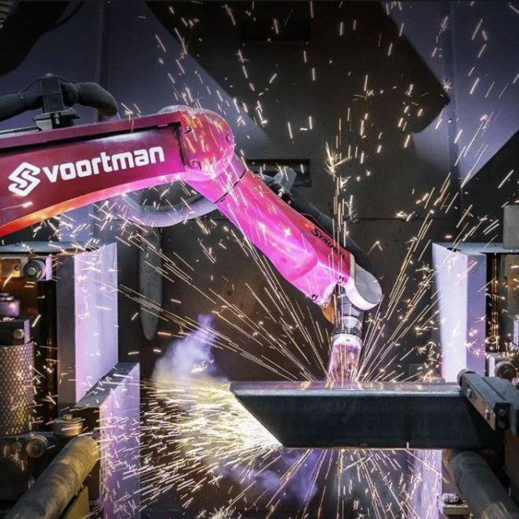
Active and Passive Voice
Present Simple in Mechatronics

Slide 2

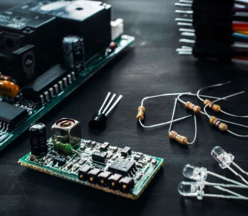


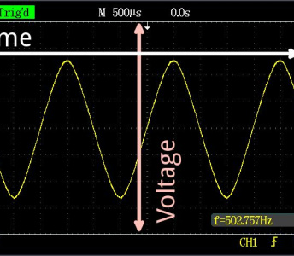
Key Vocabulary
Sensor
A device that detects changes in the environment.
System
A group of parts working together as a whole.
Energy
The power needed to make machines work and move.
Signal
An electrical impulse that carries information.

Slide 3

What is Active Voice?
The Focus
In active voice, the subject of the sentence performs the action.
Structure
Subject + Verb + Object
Example
The engineer programs the robot.
Here, the engineer is doing the action.

Slide 4
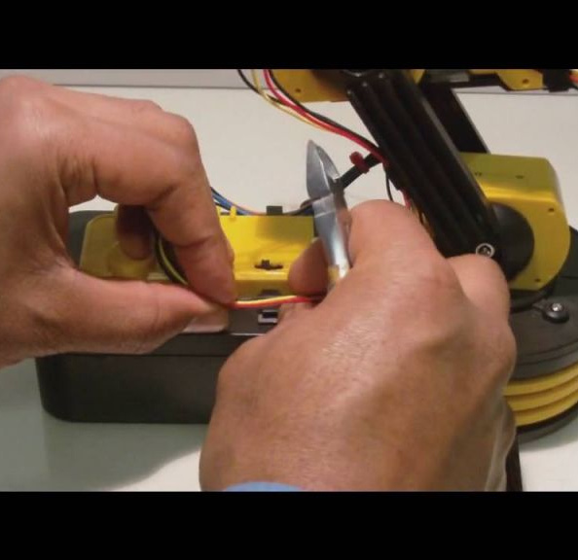
What is Passive Voice?
The Focus
In passive voice, the object receives the action. The focus is on the result, not who did it.
Structure
Object + am/is/are + Verb (past participle) + by Subject
Example
The robot is programmed by the engineer.
Here, the robot is the focus.

Slide 5
Active vs. Passive Comparison
Active Voice
The technician fixes the sensor.
The computer processes data.
We use energy efficiently.
Key Point: The subject does the action.
Passive Voice
The sensor is fixed by the technician.
Data is processed by the computer.
Energy is used efficiently.
Key Point: The action happens to the subject.

Slide 6
Grammar Check
Answers on the next slide...
Which sentence is in the passive voice?
1.
The system controls the temperature.
2.
The temperature is controlled by the system.
3.
Sensors detect movement.
4.
We program the machine.

Slide 7
Grammar Check
✅​
Which sentence is in the passive voice?
1.
The system controls the temperature.
2.
The temperature is controlled by the system.
👍​
3.
Sensors detect movement.
4.
We program the machine.

Slide 8

Fill in the blanks 🧩​
The mechanical arm ____ moved by the motor. The data ____ sent to the computer.
Word bank 🏦​
is, is, are, am
Answers on the next slide...

Slide 9
Fill in the blanks 🧩​
✅​
The mechanical arm is moved by the motor. The data is sent to the computer.
Word bank 🏦​
is, is, are, am

Slide 10
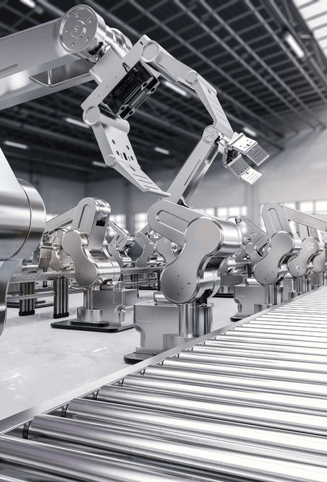
Reading: Mechatronics Systems
Vocabulary Analysis
Read the text below. We will analyse the words in the next activity.
In a mechatronics system, sensors detect movement. This information is sent to the controller. The motor then moves the mechanical arm. The process is automatic.

Slide 11
Match the words with the definitions 🎯​
1.
Process
a)
Noun: Facts or details about something.
2.
Information
b)
Adjective: Related to machines or moving parts.
3.
Mechanical
c)
Noun: A series of actions or steps.
4.
Sensor
d)
Noun: A device that detects something.

Slide 12
Match the words with the definitions 🎯​
✅​
1.
Process
c)
Noun: A series of actions or steps.
2.
Information
a)
Noun: Facts or details about something.
3.
Mechanical
b)
Adjective: Related to machines or moving parts.
4.
Sensor
d)
Noun: A device that detects something.

Slide 13

Summary
Today's Lesson
Active Voice: Subject does the action (e.g., 'The robot moves').
Passive Voice: Object receives the action (e.g., 'The robot is moved').
Vocabulary: We learned words like sensor, energy, and system.
Keep practising by looking at technical manuals!

