Slide 1


GRUPO 3
Fernandez Florencia
Simonini Milagros

Slide 2
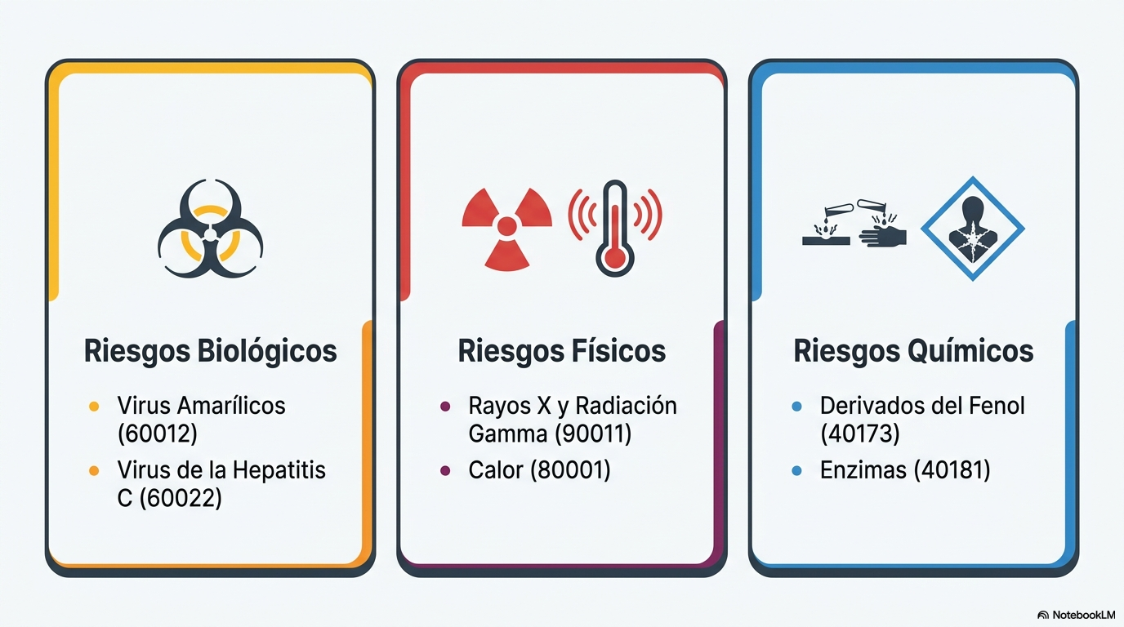

Slide 3
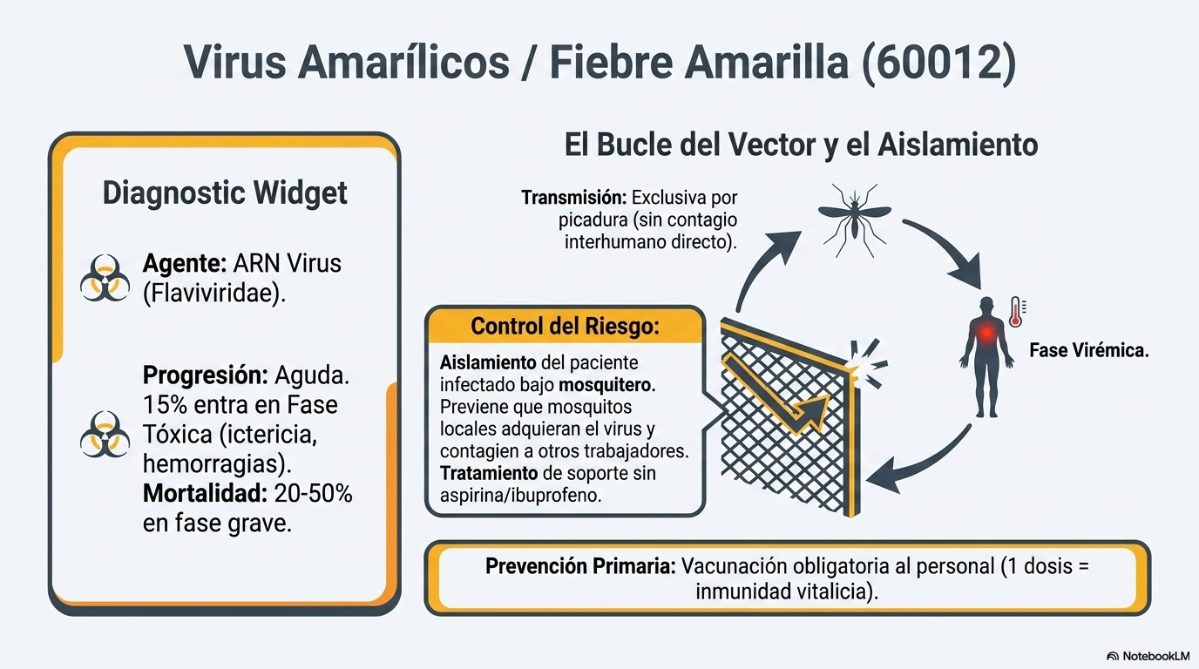

Slide 4
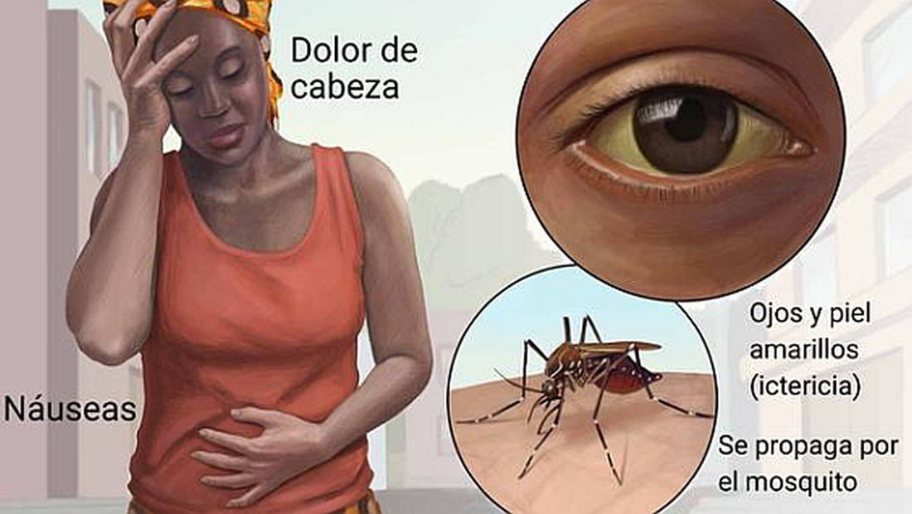
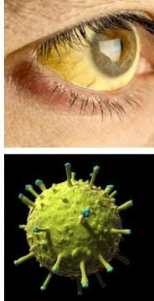

Slide 5

https://www.youtube.com/watch?v=f2mLc7WJAyM

Slide 6
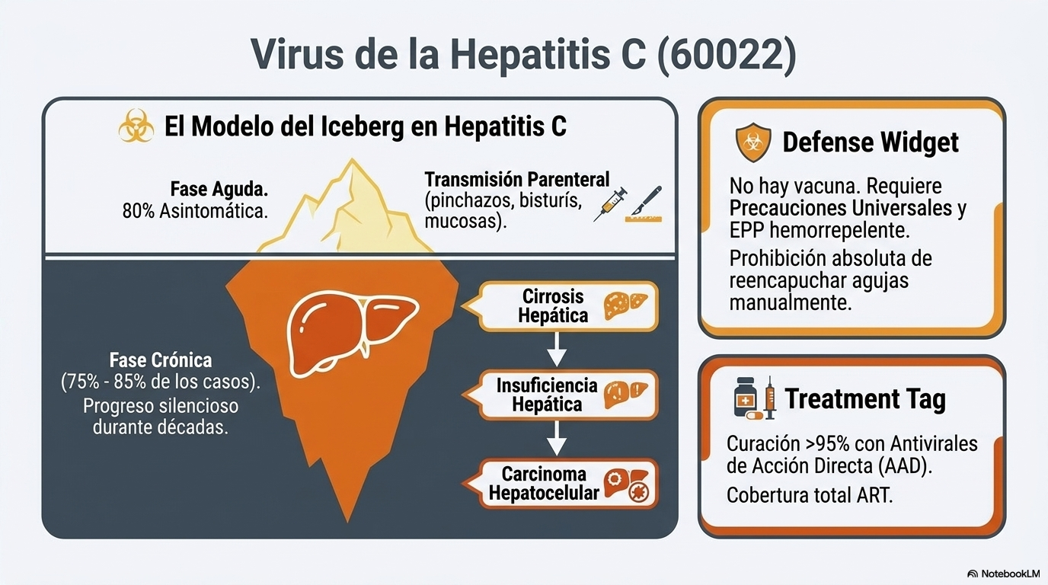

Slide 7
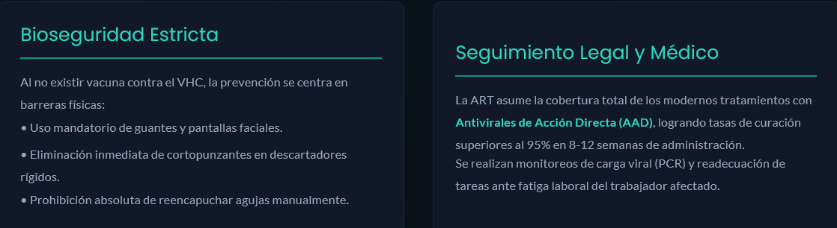

Slide 8

https://www.youtube.com/watch?v=didy2yJ5fUQ

Slide 9
